Slide 1
Chapter 8 Arrays and Strings

Slide 2
Introduction
Simple data type: variables of these types can store only one value at a time
Structured data type: a data type in which each data item is a collection of other data items

Slide 3

Arrays
Array: a collection of a fixed number of components, all of the same data type
One-dimensional array: components are arranged in a list form
Syntax for declaring a one-dimensional array:
intExp: any constant expression that evaluates to a positive integer

Slide 4

Accessing Array Components
General syntax:
indexExp: called the index
An expression with a nonnegative integer value
Value of the index is the position of the item in the array
[]: array subscripting operator
Array index always starts at 0

Slide 5


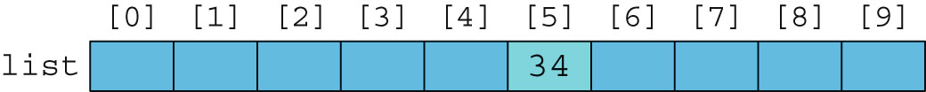
Accessing Array Components (cont’d.)

Slide 6

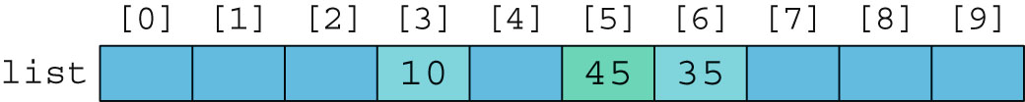
Accessing Array Components (cont’d.)

Slide 7
Processing One-Dimensional Arrays
Basic operations on a one-dimensional array:
Initializing
Inputting data
Outputting data stored in an array
Finding the largest and/or smallest element
Each operation requires ability to step through elements of the array
Easily accomplished by a loop

Slide 8
Processing One-Dimensional Arrays (cont’d.)
Given the declaration:
int list[100]; //array of size 100
int i;
Use a for loop to access array elements:
for (i = 0; i < 100; i++) //Line 1
cin >> list[i]; //Line 2

Slide 9
Array Index Out of Bounds
Index of an array is in bounds if the index is >=0 and <= ARRAY_SIZE-1
Otherwise, the index is out of bounds
In C++, there is no guard against indices that are out of bounds

Slide 10
Array Initialization During Declaration
Arrays can be initialized during declaration
Values are placed between curly braces
Size determined by the number of initial values in the braces
Example:
double sales[] = {12.25, 32.50, 16.90, 23, 45.68};

Slide 11
Partial Initialization of Arrays During Declaration
The statement:
int list[10] = {0};
Declares an array of 10 components and initializes all of them to zero
The statement:
int list[10] = {8, 5, 12};
Declares an array of 10 components and initializes list[0] to 8, list[1] to 5, list[2] to 12
All other components are initialized to 0

Slide 12

Some Restrictions on Array Processing
Aggregate operation: any operation that manipulates the entire array as a single unit
Not allowed on arrays in C++
Example:
Solution:

Slide 13
Copy a1 to a2
a3=a1+a2
Max/Min

Slide 14
Arrays as Parameters to Functions
Arrays are passed by reference only
Do not use symbol & when declaring an array as a formal parameter
Size of the array is usually omitted
If provided, it is ignored by the compiler
Example:

Slide 15
Constant Arrays as Formal Parameters
Can prevent a function from changing the actual parameter when passed by reference
Use const in the declaration of the formal parameter
Example:
Void sum( const int a1[], const int a2[], int a3[])

Slide 16
Example
void sum( const int a1[], const int a2[], int a3[])
{
for(int i=0; i<s1; i++)
{
a3[i]=a1[i]+a2[i];
}
}
int main()
{
int a1[3]={10,3,9};
int a2[3]={2,4,0};
int a3[3];
sum(a1,a2,a3);
for(int i=0;i<3;i++)
cout<<a3[i]<<" ";
return 0;
}

Slide 17
Base Address of an Array and Array in Computer Memory
Base address of an array: address (memory location) of the first array component
Example:
If list is a one-dimensional array, its base address is the address of list[0]
When an array is passed as a parameter, the base address of the actual array is passed to the formal parameter

Slide 18
Functions Cannot Return a Value of the Type Array
C++ does not allow functions to return a value of type array

Slide 19
Searching an Array for a Specific Item
Sequential search (or linear search):
Searching a list for a given item, starting from the first array element
Compare each element in the array with value being searched for
Continue the search until item is found or no more data is left in the list

Slide 20
Bubble Sort
Bubble Sort is the simplest sorting algorithm that works by repeatedly swapping the adjacent elements if they are in wrong order.

Slide 21
Bubble Sort- Example
#include<iostream>
using namespace std;
void bubble(int a[],int s)
{
int temp;
for(int i2=0; i2<=4; i2++)
{
for(int j=0; j<4; j++)
{
//Swapping element in if statement
if(a[j]>a[j+1])
{
temp=a[j];
a[j]=a[j+1];
a[j+1]=temp;
}
}
}
}
}

Slide 22
Bubble Sort- Example Cont.
int main(){
//declaring array
int array[5]={10,2,30,8};
cout<<"Input array is: "<<endl;
for(int j=0; j<5; j++)
{
cout<<array[j]<<" ";
}
cout<<endl;
// Bubble Sort Starts Here
bubble(array,5);
// Displaying Sorted array
cout<<" Sorted Array is: "<<endl;
for(int j=0; j<5; j++)
{
cout<<array[j]<<" ";
}
return 0;

Slide 23
Histogram1
const int s1=4;
void Histogram1(int a[])
{
for(int i=0; i<s1; i++)
{
for(int j=0;j<a[i];j++)
cout<<"*";
cout<<endl;
}
}
int main(){
int a1[s1]={10,3,7,2};
Histogram1(a1);
return 0;
}

Slide 24
Histogram
const int s1=8;
void Histogram(int a[],int b[])
{for(int i=0; i<s1; i++)
{b[a[i]] ++;}
}
int main(){
int a1[s1]={0,1,2,1,1,1,2,};
int a2[3]={0};
Histogram(a1,a2);
for(int j=0; j<3; j++)
{cout<<a2[j]<<" ";
}
return 0;
}

Slide 25
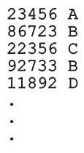
Parallel Arrays
Two (or more) arrays are called parallel if their corresponding components hold related information
Example:
int studentId[50];
char courseGrade[50];

Slide 26

Two- and Multidimensional Arrays
Two-dimensional array: collection of a fixed number of components (of the same type) arranged in two dimensions
Sometimes called matrices or tables
Declaration syntax:
intExp1 and intExp2 are expressions with positive integer values specifying the number of rows and columns in the array

Slide 27

Accessing Array Components
Accessing components in a two-dimensional array:
Where indexExp1 and indexExp2 are expressions with positive integer values, and specify the row and column position
Example:
sales[5][3] = 25.75;

Slide 28
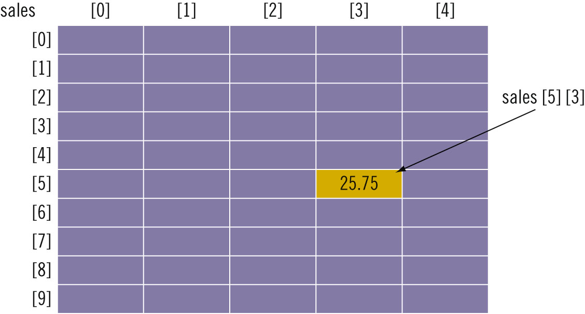
Accessing Array Components (cont’d.)

Slide 29
Two-Dimensional Array Initialization During Declaration
Two-dimensional arrays can be initialized when they are declared:
Elements of each row are enclosed within braces and separated by commas
All rows are enclosed within braces
For number arrays, unspecified elements are set to 0

Slide 30
int b[2][2]={ {1,2}, {2,3} };
int c[2][2]={ {1}, {2,3} };
int d[3][2]={ {1}, {2,3} };
int e[3][3]={ {1},{0}, {2,3} };
1 | 2
2 | 3
1 | 0
2 | 3
1 | 0
2 | 3
0 | 0
1 | 0 | 0
0 | 0 | 0
2 | 3 | 0

Slide 31
Processing Two-Dimensional Arrays
Ways to process a two-dimensional array:
Process entire array
Row processing: process a single row at a time
Column processing: process a single column at a time
Each row and each column of a two-dimensional array is a one-dimensional array
To process, use algorithms similar to processing one-dimensional arrays

Slide 32


Initialization
Examples:
To initialize row number 4 (fifth row) to 0:
To initialize the entire matrix to 0:

Slide 33
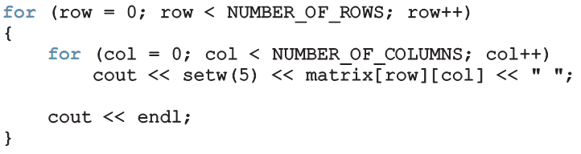
Print
Use a nested loop to output the components of a two dimensional array:

Slide 34


Input
Examples:
To input into row number 4 (fifth row):
To input data into each component of matrix:

Slide 35
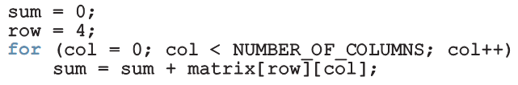
Sum by Row
Example:
To find the sum of row number 4:

Slide 36
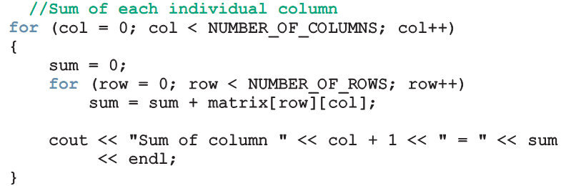
Sum by Column
Example:
To find the sum of each individual column:

Slide 37
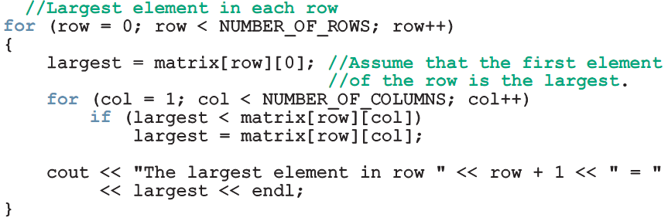
Largest Element in Each Row and Each Column
Example:
To find the largest element in each row:

Slide 38
Passing Two-Dimensional Arrays as Parameters to Functions
Two-dimensional arrays are passed by reference as parameters to a function
Base address is passed to formal parameter
Two-dimensional arrays are stored in row order
When declaring a two-dimensional array as a formal parameter, can omit size of first dimension, but not the second

Slide 39
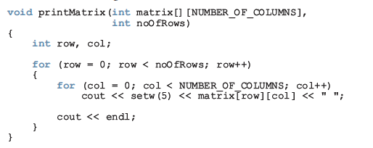
Passing Two-Dimensional Arrays as Parameters to Functions

Slide 40
#include <iostream>
using namespace std;
const int r = 2;
const int c = 3;
void sumRows(int matrix[][c],int r);
void largestInRows(int matrix[][c],int c);
int main()
{
int board[r][c]= {{23, 5, 6}, { 16, 24, 67},};
cout << endl;
sumRows(board, r);
cout << endl;
largestInRows(board, r);
return 0;
}
void largestInRows(int matrix[][c],int noOfRows)
{ int row, col;
int largest;
for (row = 0; row < noOfRows; row++)
{
largest = matrix[row][0]; //Assume the first element of the row is the largest.
for (col = 1; col < c; col++)
if (largest < matrix[row][col])
largest = matrix[row][col];
cout << "The largest element of row " << (row + 1)
<< " = " << largest << endl;}}
void sumRows(int matrix[][c], int noOfRows)
{ int row, col;
int sum;
for (row = 0; row < noOfRows; row++)
{ sum = 0;
for (col = 0; col < c; col++)
sum = sum + matrix[row][col];
cout << "Sum of row " << (row + 1) << " = " << sum<< endl; }}

Slide 41
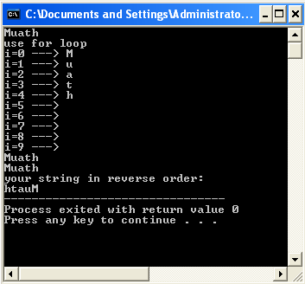
#include <iostream>
using namespace std;
int main()
{
char myStr[10] = "Muath";
cout << myStr << endl;
cout << "use for loop" << endl;
for (int i=0;i<10;i++)
cout<<"i="<<i<<" ---> "<<myStr[i]<<endl;
for (int i=0;i<10;i++)
cout<<myStr[i];
cout<<endl;
for (int i=0;myStr[i]!='\0';i++)
cout<<myStr[i];
cout<<"\nyour string in reverse order:\n"
int j;
for (j=0;j<10;j++)
if (myStr[j]=='\0') break;
for (int x=j;x>=0;x--)
cout<<myStr[x];
return 0;
}

